Slide 1
Tugas 2 Kalkulus Dasar
Galih Anggoro Prasetya | 22205018 | TI

Slide 2

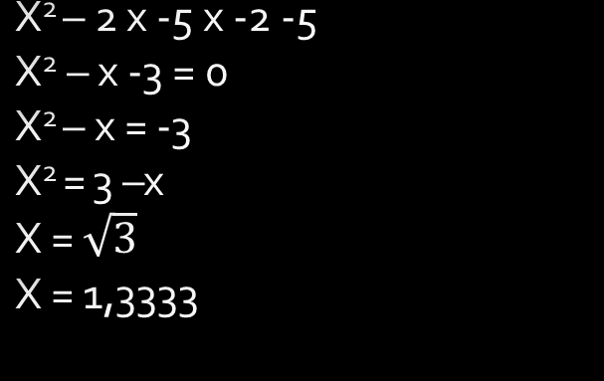

Latihan Soal
1.) $\frac{(2x −5)}{(x −2)}$ < 1
(x-2) x -5 < $\frac{5}{x−2}$ (x-2) =1
X² – 2 x -5 x -2 -5
X² – x -3 = 0
X² – x = -3
X² = 3 –x
X = $\sqrt{3}$
X = 1,3333

Slide 3

Latihan Soal
2.) 4x – 7 < 3x + 5
4x – 3x < 5 + 7
1x < 12
x < $\frac{12}{1}$
x < 12 grafik

Slide 4

Latihan Soal
3.) 2x + 16 < x + 25
2x – x < 25 – 16
1x < $\frac{9}{1}$
x < 9

Slide 5

Latihan Soal
4.) 7x – 1 ≤ 10x + 4
7x – 10x ≤ 4 + 1
-3x ≤ 5
x ≥ $\frac{5}{−3}$
x ≥ 1,666

